Slide 1
Lab 1
Java Environment setup
Prepared by:-Zerihun T.

Slide 2
Java Environment setup
Download and Install JDK(Java Development Kit)
Setup Java Environment
Download, Install and Configure IntelliJ Idea Idle

Slide 3
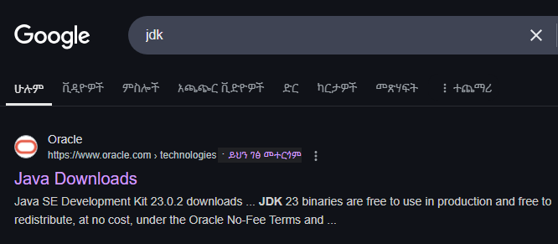
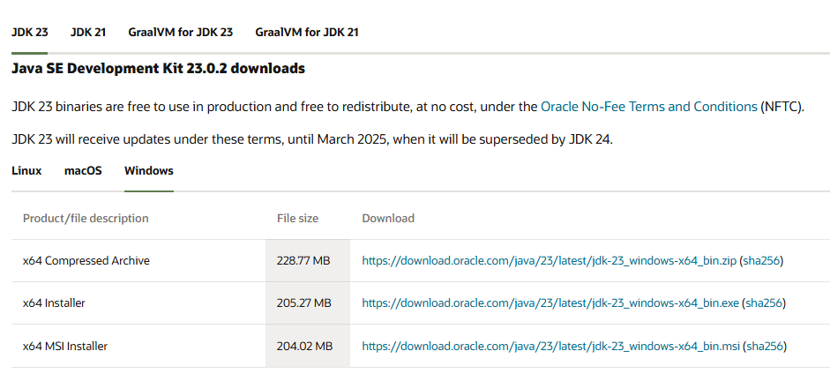
Download and Install JDK(Java Development Kit

Slide 4
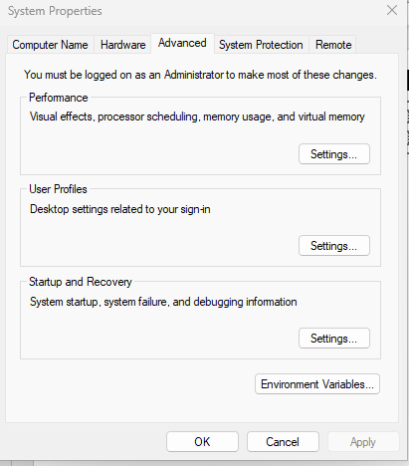
Setup Java Environment
Steps1:-Search environment
Click edit system Environment variables

Slide 5
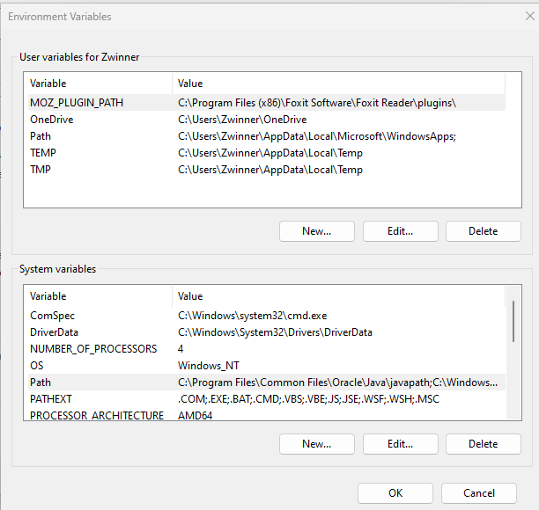
Double Click on the path

Slide 6
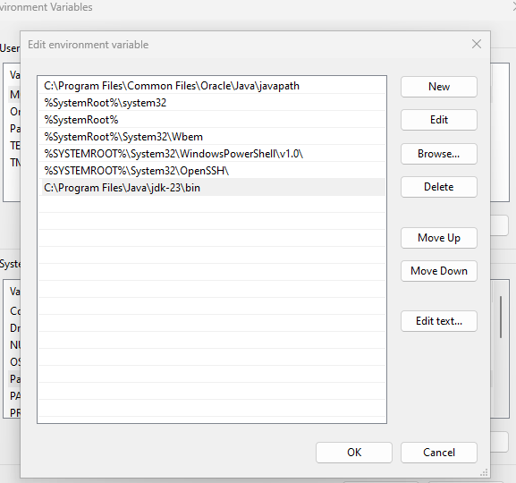
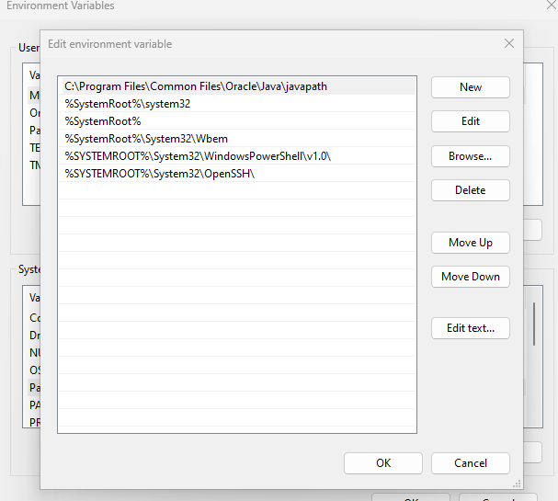
Paste C:\Program Files\Java\jdk-23\bin
Click
Paste

Slide 7
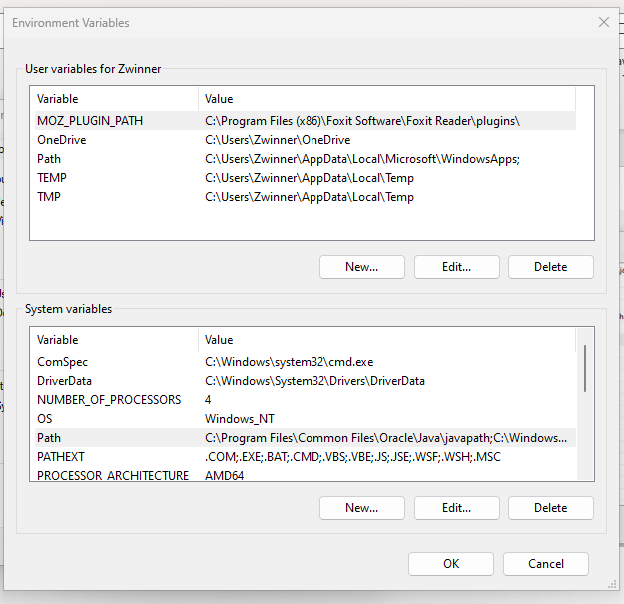
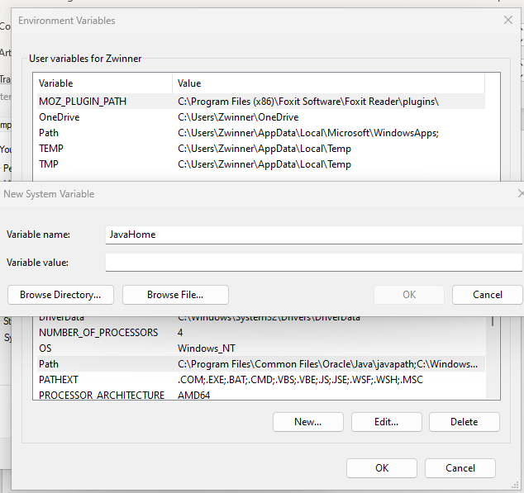
Give name as you Want
Click

Slide 8
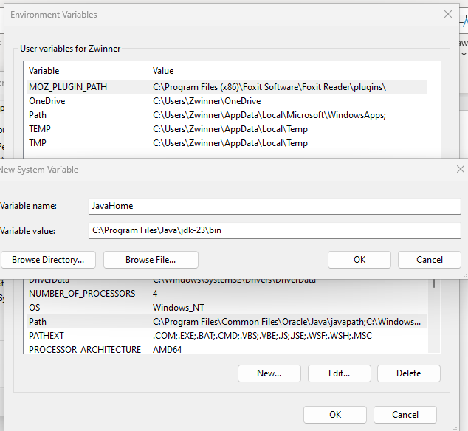
Delete the Bin up to slash Line
Delete the Bin up to slash Line

Slide 9
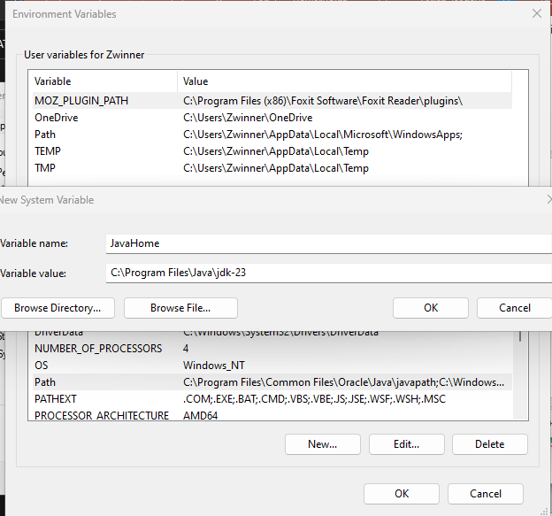
Ok and Finalize

Slide 10
Check up JDK installed
Assuming you are working in Windows environment, checking whether JDK is installed or not is quite simple:
Open up command prompt (cmd). ...
Check the version java –version
Once the command prompt opens up (the typical "black screen"), type in the command javac.

Slide 11
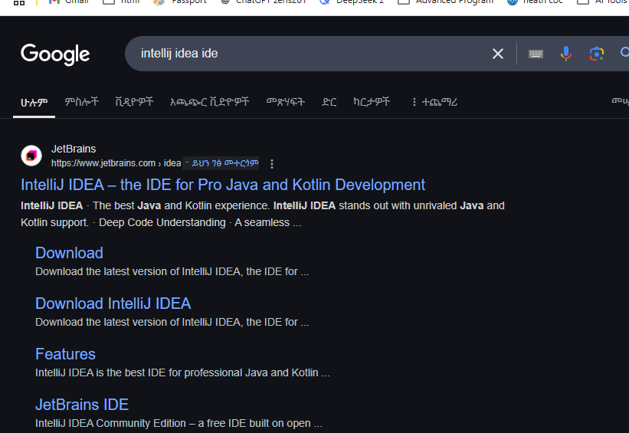

Editor Download, Install and Configure IntelliJ Idea Idle or NetBeans

Slide 12
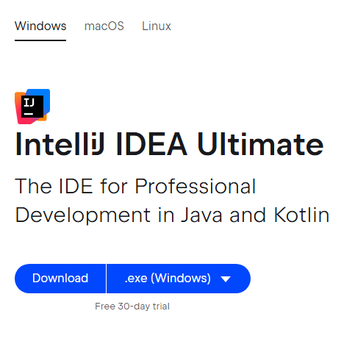
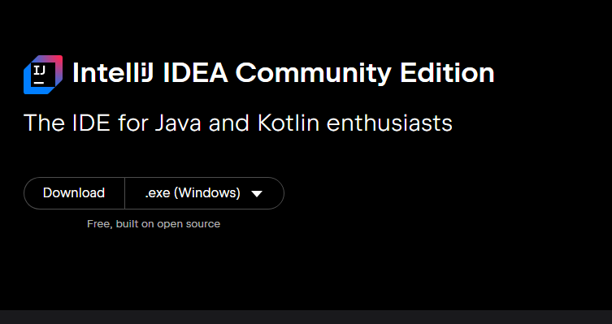

Slide 13
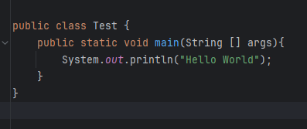
Java Syntax
Every line of code that runs in Java
must be inside a class
A class should always start with
uppercase first letter.(Java is case sensitive )
The main method public static void main(String [] args) every java should have at least one main method
Any code inside the main() method will be excuted
Every java statement code end with semicolon.

Slide 14
Java Output
displaying data or results to the console or other output streams. The most common way to produce output in Java is by using the System.out object, which provides methods like print(), println(), and printf()
1. System.out.println()
Prints a line of text to the console and adds a newline character (\n) at the end.
Useful for displaying output and moving to the next line.
2. System.out.print()
Prints text to the console without adding a newline character.
Useful for printing multiple items on the same line.
3. System.out.printf()
Used for formatted output, similar to printf in C.
Allows you to specify placeholders for variables and control formatting.
4. Concatenation in Output
You can combine strings and variables using the + operator.

Slide 15
Java Programming comments
In Java, comments are non-executable lines of text used to explain or document code. They are ignored by the compiler and are meant for developers to understand the code better. Java supports two types of comments:
1. Single-Line Comments
Starts with // and continues until the end of the line.
Used for short explanations or notes.
2. Multi-Line Comments
Starts with /* and ends with */.
Can span multiple lines.
Used for longer explanations or commenting out blocks of code.

Slide 16
Example:-
package Introduction; public class HelloWorld { public static void main(String[] args) { System.out.println("hello World"); } }
Exercise1
Output
1.Write a class named greet that gets a name as input and prints ”Hello, your name” .
2.“This is my first Java program!”

Slide 17
What Variable?
1. Local Variables
Declared inside a method, constructor, or block.
Must be initialized before use.
Scope is limited to the block in which they are declared.
Key Concepts of Variables
Name (Identifier):
A unique name given to the variable.
Follows specific naming rules (e.g., cannot start with a number, cannot use reserved keywords).
Data Type:
Defines the type of data the variable can store (e.g., int, double, String).
Value:
The actual data stored in the variable.
Scope:
The region of the program where the variable is accessible
2. Instance Variables
Declared inside a class but outside any method.
Belong to an instance of the class (object).
Initialized with default values if not explicitly assigned (e.g., 0 for int, null for String).
3. Static Variables
Declared with the static keyword inside a class but outside any method.
Belong to the class rather than any specific instance.
Shared across all instances of the class.
Initialized with default values if not explicitly assigned

Slide 18
Summary Table of Data Types
Data Type | Description | Size | Default Value | Example
String | Sequence of characters (text) | Variable | null | String name = "Alice";
int | Whole numbers (integers) | 4 bytes | 0 | int age = 25;
float | Single-precision decimal numbers | 4 bytes | 0.0f | float price = 19.99f;
char | Single character | 2 bytes | \u0000 | char grade = 'A';
boolean | True or false values | JVM-defined | false | boolean isJavaFun = true;

Slide 19
Declaring variable
data_type variable_name; // Declaration
data_type variable_name = value; // Declaration with initialization
Rules for Declaring Variables
Variable names must start with a letter, underscore (_), or dollar sign ($).
Subsequent characters can be letters, digits, underscores, or dollar signs.
Variable names are case-sensitive start lower case letter and canot contain whitespace (e.g., age and Age are different).
Reserved keywords (e.g., int, class, public) cannot be used as variable names.
Use meaningful and descriptive names (e.g., userAge instead of a).
Key Points to Remember
Always declare variables before using them.
Local variables (inside methods) must be initialized before use.
Instance and static variables are initialized with default values if not explicitly assigned.
Use meaningful variable names for better readability.

Slide 20
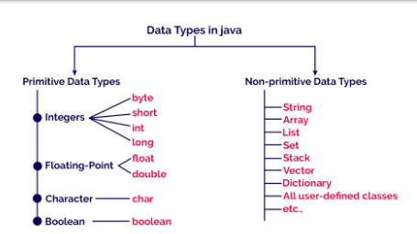
Java data type
1.Primitive Data(Intrinsic or Bulit-in data ) : Basic data types that store simple values.
2.Non-Primitive(Derived or Reference Types): Complex data types that store references to object. : These are created by the users

Slide 21
Example on variable
public class Variable { public static void main(String[] args) { static int age=25; static double height=1.75; System.out.println("age: "+ age); System.out.println("Height " + height); }
Output
age: 25
Height: 1.75
Exercise
Declare class name VariableExample
// Instance Variable (belongs to an object)
String instanceVar = "I am an instance variable";
// Static Variable (belongs to the class)
static String staticVar = "I am a static variable";
public void display() {
// Local Variable (declared inside a method)
Under main method
// Creating an object of the class
Output
Local Variable: 100
Instance Variable: I am an instance variable
Static Variable: I am a static variable

Slide 22
Access Modifiers in Java .Java provides four types of access modifiers:
Modifier | Class | Package | Subclass | World (Other Packages)
private | ✅ Yes | ❌ No | ❌ No | ❌ No
default (No modifier) | ✅ Yes | ✅ Yes | ❌ No | ❌ No
protected | ✅ Yes | ✅ Yes | ✅ Yes | ❌ No
public | ✅ Yes | ✅ Yes | ✅ Yes | ✅ Yes
Access modifiers in Java control the visibility and accessibility of classes, methods, and variables
Modifier | Class | Method/Variable | Access Level
private | ❌ No | ✅ Yes | Only within the same class
default | ✅ Yes | ✅ Yes | Same package only
protected | ❌ No | ✅ Yes | Same package + subclasses in other packages
public | ✅ Yes | ✅ Yes | Accessible everywhere

Slide 23
1. Private (Most Restrictive)
2. Default (Package-Private)
Can be accessed only within the same class.
Not accessible outside the class (not even by subclasses).
No modifier means default access
.Accessible only within the same packag
Package DataScience.Modifiers;
class DefaultDemo{
int data =200// Default access modifier
void display(){// Default method
System.out..println("Data: "+ data)
// Another class in the same package
}}
class Test {
public static void main(String[] args){
DefaultDemo obj = new DefaultDemo
obj.display()// ✅ Allowed (same package)
package DataScience.Modifiers;
public class PrivateDemo {
private int data = 10// Private variable
private void display(){// Private method
System.out..println("Data: "+ data)
public static void main(String[] args) {
PrivateDemo obj = new PrivateDemo();
obj.display(); // ✅ Allowed inside the same class
}}
class Another
public static void main(String[] args) {
PrivateDemo obj = new PrivateDemo ();
//obj.data = 20; ❌ Error: data has private access
// obj.display(); ❌ Error: display() is private
}}
OutPut is:- 200
OutPut is:- 100
Note: If Example is in a different package, Testcannot access its members.

Slide 24
3.Protected
4. Public (Least Restrictive)
Accessible within the same package
Accessible in subclasses (even if in different packages).
Accessible everywhere.
packageDataScience.Modifiers.Pakage1;
public class ProtectedDemo { //not default
protected int data = 10;
public void display(){
System.out.println("Data: " +data);
}}
package PublicExample1
public class Example {
public int data =100;
public void display(){
System.out.println("Data: " +data);
package DataScience.Modifiers.Pakege2;
import DataScience.Modifiers.Pakage1.ProtectedDemo;
class Test extends ProtectedDemo{
public static void main(String[] args) {
Test obj = new Test();
obj.display()// ✅ Allowed (public access)
OutPut is:- 10
🚨 Note:protected members cannot be accessed directly from a different package unless it's via inheritance

Slide 25
Scannr Class
Entering Information frome the Console
The Scanner class in Java is used to take input from the user. It is part of the java.util package.
Before using the Scanner class, import it:
import java.util.Scanner;
Creating a Scanner Object
// For reading from console (System.in)
Scanner scanner = new Scanner(System.in);
// For reading from a string
Scanner stringScanner = new Scanner("Hello World 123");
// For reading from a file
Scanner fileScanner = new Scanner(new File("input.txt"));

Slide 26
2 Methods of Scanner Class
Method | Description
next() | Reads a single word (stops at space)
nextLine() | Reads a full line (including spaces)
nextInt() | Reads an integer
nextDouble() | Reads a double (decimal number)
nextBoolean() | Reads a boolean (true/false)
nextFloat() | Reads a float
nextLong() | Reads a long integer
nextByte() | Reads a byte

Slide 27
Basic Example:
Taking User Input Program1
Example: Reading Different Data Types
import java.util.Scanner;// Import Scanner
public class ScannerDemo; {
public static void main(String[] args) {
//For reading from console (System.in)
// Create Scanner object
Scanner scanner = new Scanner(System.in);
System.out.print(“Enter your name: ");
String name = scanner.nextLine()// Read a String
System.out.print(""Enter your age: ":);
int age= scanner.nextInt(); // Read an Integer
System.out.println("Hello " +name ", you are " +age "+ years old.");
scanner.close(); Close scanner (best practice)
public class InputExample
public static void main(String[] args) {
Scanner scanner new (Systemin);
stem.out.print("Enter an integer: ")
int num =scanner.nextInt();//Reads an integer
System.out.print("Enter a decimal number: ")
double price = scanner.nextDouble();//Reads a double
System.out.print("Enter a word: ");
String word = scanner.next();// Reads a single word (stops at space)
System.out.print("Enter a full sentence: ")
scanner.nextLine();();// Reads a full line (including spaces String sentence = scanner.nextLine()// Reads a full line (including spaces)
System.out.print(t"Integer: " num)
System.out.print("Double: " price)
System.out.print("Word: " word)
System.out.print("Sentence: " sentence)
scanner.close(); Close scanner (best practice)

Slide 30
Categories of Java Keywords
Category | Keywords
Data Types | byte, short, int, long, float, double, char, boolean
Control Flow | if, else, switch, case, default, while, do, for, break, continue, return
Access Modifiers | private, protected, public
Class & Object | class, interface, enum, abstract, extends, implements, new
Exception Handling | try, catch, finally, throw, throws
Object & Memory Management | super, this, static, final, void, synchronized, volatile
Package Management | import, package
Thread Management | synchronized, volatile
Boolean Values | true, false, null
Others | instanceof, native, strictfp, transient, assert, default, goto, const (reserved but not used)

